Slide 1
Database System Concepts and Architecture

Slide 2
Database Design Methodology/Process
Database Design Process
requirements collection and analysis:
Here, the database designers interview prospective database users to understand and document their data requirements
The result of this step is a concisely written set of users’ requirements
Functional requirements:
these are also specified in parallel with requirement collection
These consist of the user-defined operations (or transactions) that will be applied to the database, including both retrievals and updates.
conceptual design:.
Once all the requirements have been collected and analyzed, the next step is to create a conceptual schema for the database, using a high-level conceptual data model
includes detailed descriptions of the entity types, relationships, and constraints

Slide 3
logical design or data model mapping:
Deals with the actual implementation of the database
use an implementation data model such as the relational or the object-relational database model-so the conceptual schema is transformed from the high-level data model into the implementation data model
Physical design:
Here the internal storage structures, indexes, access paths, and file organizations for the database files are specified
Eg database administrator (DBA) would implement the physical schema
Store index in a separate disk location
Start with 100MB
Grow by 50MB when full
Never exceed 10GB
Reserve 10% space for updates

Slide 4
Think of database design as building a house with three levels of planning:
Conceptual Schema: The architect's rough sketch showing there will be bedrooms, a kitchen, and a bathroom. (What data is needed?)
Logical Schema: The detailed blueprint showing room dimensions, door locations, and how rooms connect. (How is data structured and related?)
Physical Schema: The actual construction plan specifying concrete type, nail sizes, pipe materials, and wiring gauges. (How is data actually stored on the disk?)

Slide 5
Data models schemas and instances
One characteristics of data base approach is data abstraction-hides the details of the storage that is not needed by users.
Data model:
is a collection of concepts that can be used to describe the structure of a database-
provides the necessary means to achieve this abstraction.
structure of a database, means the data types, relationships, and constraints that should hold for the data.
Most data models also include a set of basic operations for specifying retrievals and updates on the database
common to include concepts in the data model to specify the dynamic aspect or behavior of a database application
Ex: Compute_GPA on a student object
generic operations to insert, delete, modify, or retrieve any kind of object are often included in the basic data model operations.

Slide 6
Categories of Data models
Data models are categorized according to the types of concepts they use to describe the database structure.
High-level or conceptual data models
provide concepts that are close to the way many users perceive data.
Conceptual data models use concepts such as entities, attributes, and relationships.
Low-level or physical data models
provide concepts that describe the details of how data is stored in the computer.
how data is stored as files in the computer by representing information such as record formats, record orderings, and access paths.
Concepts provided by low-level data models are generally meant for computer specialists, not for typical end users.

Slide 7
Schemas, Instances, and Database State
There is a distinction between description of database and data base .
The description of a database is called the database schema, also called an intension which is specified during database design
is not expected to change frequently
A displayed schema is called a schema diagram
Schema diagram displays the structure of each record type but not the actual instances of records
Each object in the schema-such as STUDENT or COURSE- is known as a schema construct.
Constraints such as data types relationships are not specified here
The data in the database at a particular moment in time is called a database state , snapshot, current set of occurrences or instances
Every time we insert or delete a record or change the value of a data item in a record, we change one state of the database into another state.

Slide 8
STUDENT
Schema diagram for the database in figure 1.2
Name | StudentNumber | Class | Major
COURSE
CourseName | CourseNumber | CreditHour | Department
PREREQUISITE
CourseNumber | PrerequisiteNumber
SECTION
SectionIdentifier | CourseNumber | Semester | Year | Instructor
GRADEREPORT
StudentNumber | SectionIdentifier | Grade

Slide 9
Schema Architecture and Data Independence
Three-schema architecture was proposed to help achieve and visualize characteristics of data base like insulation of program and data, use of catalog to store data description and support multiple user view
They are tools with which user can visualize the schema levels in database
Three schema Architecture
The goal of three schema architecture is to separate user application and the physical database. These are
Internal level: has an internal schema which describes the physical storage structure of the data base
The internal schema uses a physical data model and describes the complete details of data storage and access paths for the database

Slide 10
Schema Architecture….
2. The conceptual level: has a conceptual schema
Describes the structure of the database
Hides details of physical storage structure
concentrate on describing entities, data types, relationships, user operations, and constraints
a representational data model is used to describe the conceptual schema when a database system is implemented.
3. The external or view level
includes a number of external schemas or user views
Each external schema describes the part of the database that a particular user group is interested in and hides the rest of the database from that user group.

Slide 11
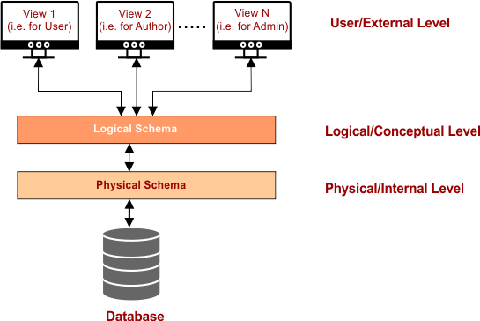
Schema Architecture….

Slide 12
Mapping:
the DBMS must transform a request specified on an external schema into a request against the conceptual schema, and then into a request on the internal schema for processing over the stored database.
Example:
for retrieval, the data extracted from the stored database must be reformatted to match the user's external view.
The processes of transforming requests and results between levels are called mappings

Slide 13
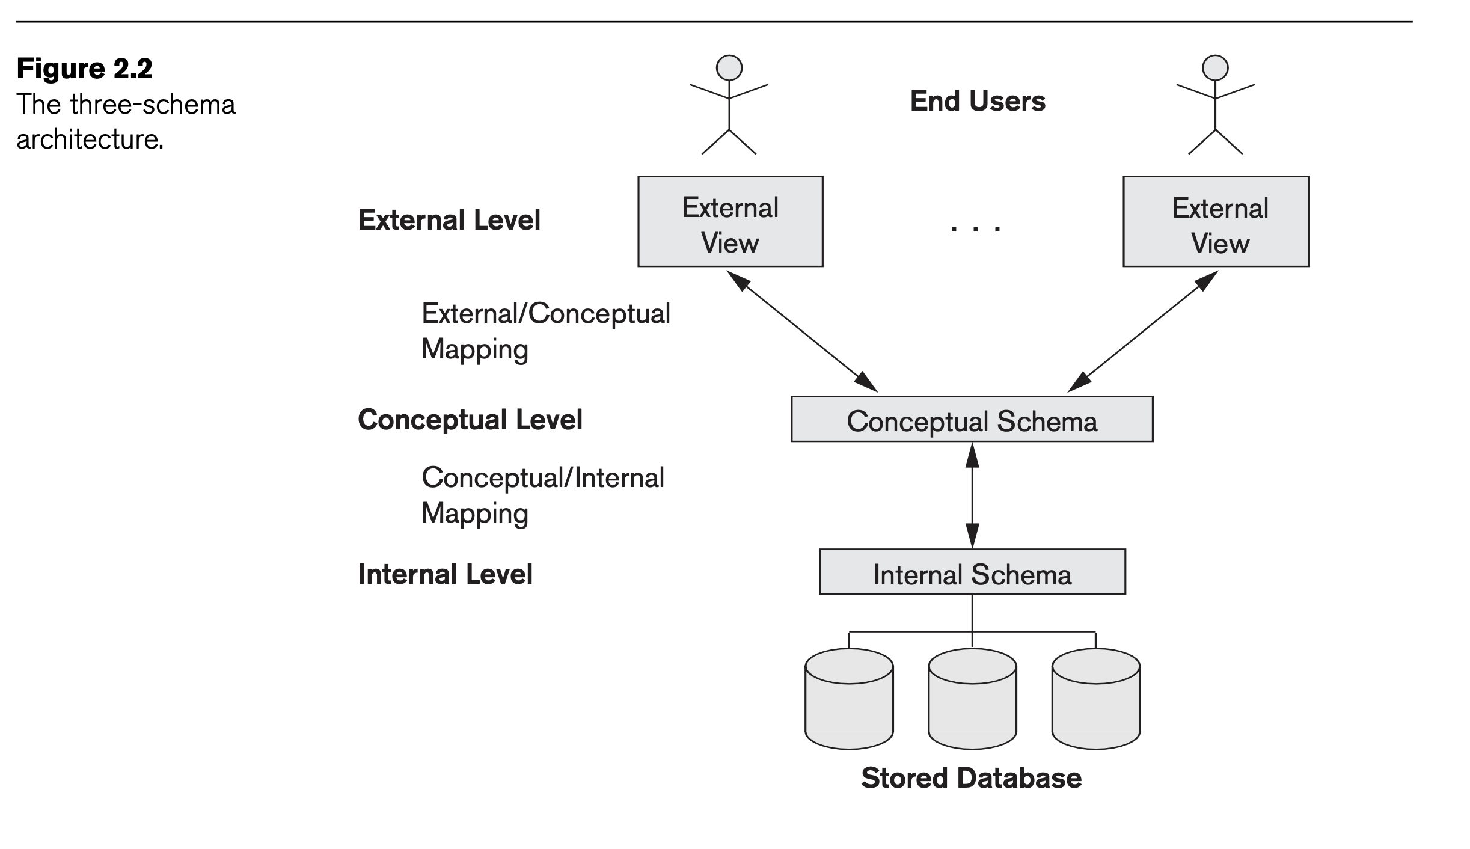

Slide 14
Data independence
is the capacity to change the schema at one level of a database system without having to change the schema at the next higher level. Two types of data independence
Logical data independence:
the capacity to change the conceptual schema without having to change external schemas or application programs
Ex : by adding or removing attribute, changing constraint
external schemas that refer only to the remaining data should not be affected
Only the view definition and the mappings need be changed in a DBMS that supports logical data independence
application programs that reference the external schema constructs must work as before

Slide 15
Physical data independence:
is the capacity to change the internal schema without having to change the conceptual schema
the external schemas need not be changed as well.
Changes to the internal schema may be needed because some physical files had to be reorganized by creating additional access structures to improve retrieval
If the same data as before remains in the database, we should not have to change the conceptual schema

Slide 16
Database language and interfaces
DBMS languages
1. Data Definition Language(DDL):
In many DBMSs where no strict separation of levels is maintained, one language, called the data definition language (DDL), is used by the DBA and by database designers to define both schemas
2. View definition language(VDL)
For a true three-schema architecture, third language, the view definition language (VDL) is needed to specify user views and their mappings to the conceptual schema

Slide 17
3. Data manipulation language
Typical manipulations include retrieval, insertion, deletion, and modification of the data
DBMS provides language called the data manipulation language (DML) for these purposes.
4. Standard Query language(SQL)
Current DBMS provide a comprehensive language like SQL for all conceptual schema definition, view definition, and data manipulation
SQL provides DDL, VDL, and DML, as well as statements for constraint specification, schema evolution, and other features

Slide 18
Classification of database management system
Several criteria are normally used to classify DBMSs. These are
1. Based on number of users supported
Single user system -support only single user at a time
Multiuser system -support multiple user
2. Based on number of site the dbms or db is distributed
Centralized-if the db is located at a single site
Distributed-the db and dbms are distributed over many sites for load balancing
3. Based on purpose of the db
Special purpose db- designed for a specific application
Ex: airline reservation, telephone directory
General purpose db - used for general purpose

Slide 19
Classification of database management system
4. Homogenous or Heterogenous
Homogeneous DDBMSs
use the same DBMS software at all the sites, whereas
Heterogeneous DDBMSs
can use different DBMS software at each site.
It is also possible to develop middleware software to access several autonomous preexisting databases stored under heterogeneous DBMSs.
This leads to a federated DBMS (or multi database system), in which the participating DBMSs are loosely coupled and have a degree of local autonomy.

Slide 20
Classification of database management system
6. Data model
relational data model
represents a database as a collection of tables,where each table can be stored as a separate file
object data model
defines a database in terms of objects, their properties, and their operations.

